Slide 1







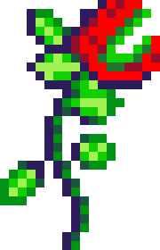


REMEMBER 2006?
LET’S PLAY!

Slide 2

how to play
There are 3 different types of games!
Answer the question
Multiple choice
Complete the word

Slide 3
ARE YOU READY?

Slide 4


Answer the question
In 2006, you might have sent your first message on which new social media platform?

Slide 5
Answer the question
Answer:
Twitter

Slide 6
Multiple choice
Whenever you turned on the radio in 2006, you might have heard “Crazy,” one of the year’s top songs, by this artist.
a. Justin Timberlake
b. Gnarls Barkley
c. Shakira
d. Ludacris

Slide 7
Multiple choice
Whenever you turned on the radio in 2006, you might have heard “Crazy,” one of the year’s top songs, by this artist.
a. Justin Timberlake
b. Gnarls Barkley
c. Shakira
d. Ludacris

Slide 8
Complete the word
Hint: In 2006, you might have watched a movie about these “on a plane.”
S_A_ES

Slide 9
Complete the word
Answer:
SNAKES

Slide 10
THANKS FOR PLAYING
END

